Slide 1
BioMetriX
By ROCKET

Slide 2
BioMetrix
BioMetrix gives users a unique ability to track multiple aspects of their health and create custom analytics to represent ongoing changes in their lives for personal or medical use.
Self Health Monitor Android Application

Slide 3
Android Application
Designed for Android 5.1 (Lollipop)
Using Android API 22
Android Studio IDE
Java
XML
Database on Amazon Web Relational Database Service utilizing SQL
Local database utilizing SQLite

Slide 4
Mood Tracking
Rate the severity of moods on a scale of 1 to 5
Default moods included: depression, elevation, anxiety, irritability
Create custom moods rated using the same 1 to 5 scale
Create multiple entries per day
Details section

Slide 5
Sleep Tracking
Time started sleeping
Total time slept
Rate quality of sleep on a scale of 1 to 10
Track health level during sleep (ie: illness, hospitalized)
Details section

Slide 6
Exercise Tracking
Create multiple entries per day
Different categories of workouts
Total exercise time
Rate intensity of workout
Details section

Slide 7
Diet Tracking
Enter total calories consumed
Rate healthiness of meals for the day
Track types of food groups you are eating from
Create custom tracking of specific nutritional values
Details section

Slide 8
Medication Tracking
Enter multiple medications
Select dose and frequency
Create daily reminders to take medication
Create reminders to refill medication
Track side effects
Details section

Slide 9
Analysis
Analyze user information
Find possible patterns related to moods, exercise, diet, and sleep
Generate graphs containing all information from a given period of time
Create custom analytics based on what user is interested in

Slide 10
System Survey

Slide 11
EMoods
Good
Free/ No Ads
Graph
Bad
Minimal Features
Ugly
User Interface
Android Mood Tracking App
Notes:
Tanna

Slide 12
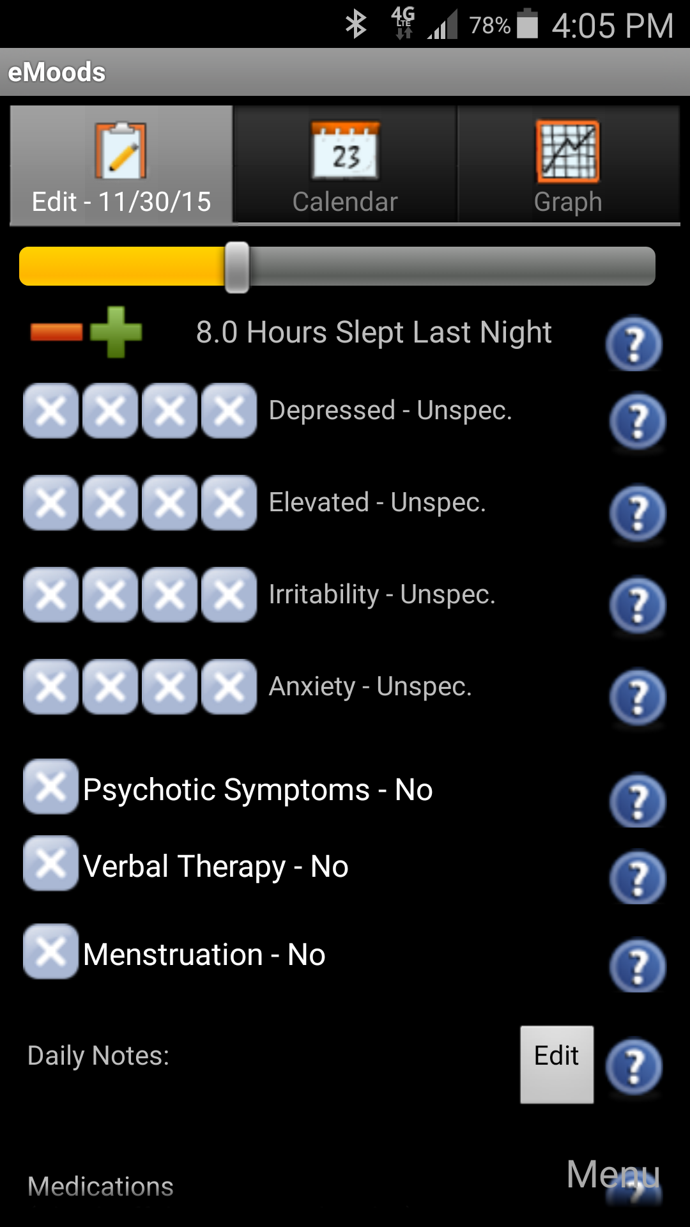
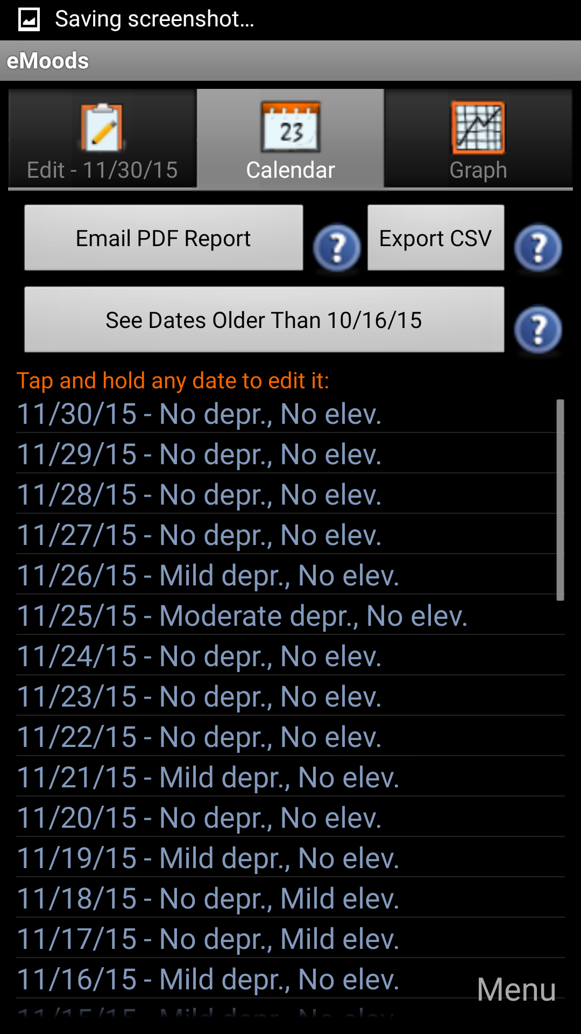
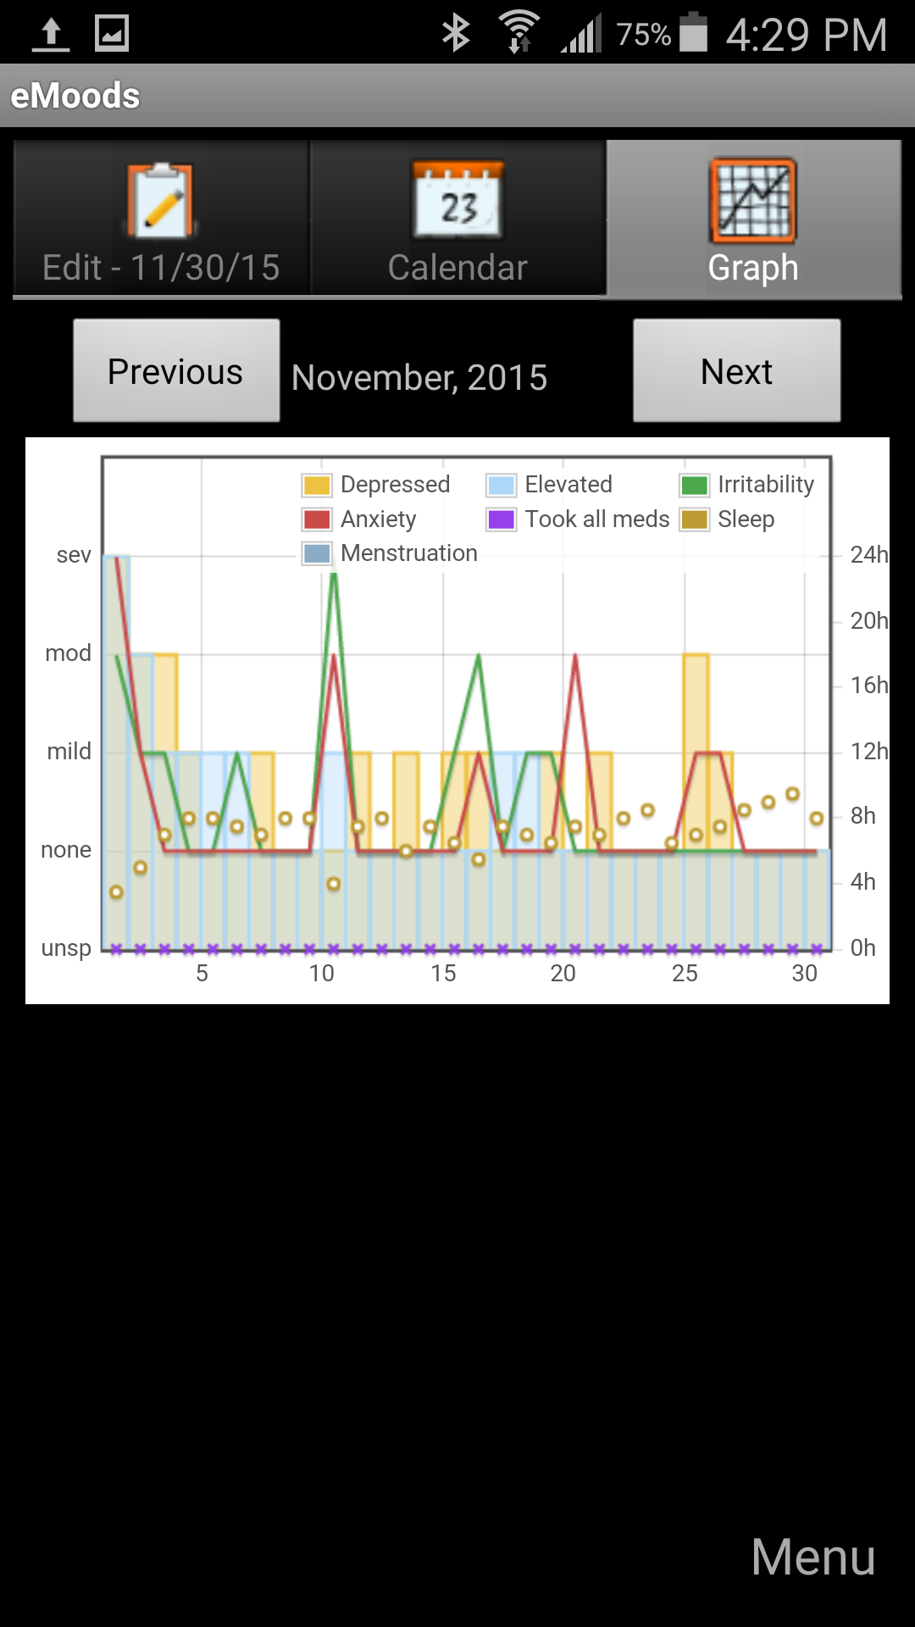

Slide 13

Sleep as Android
Good
Novel ideas to enforce alarms
Use of graphs to explain ideas
Advice based on results
Bad
Somewhat non-intuitive user-interface
Some users report issues with alarms
Cost
Free, but $4.49 for advanced features
Android Sleep Cycle Tracking

Slide 14
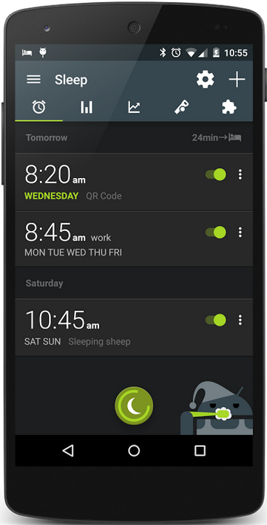
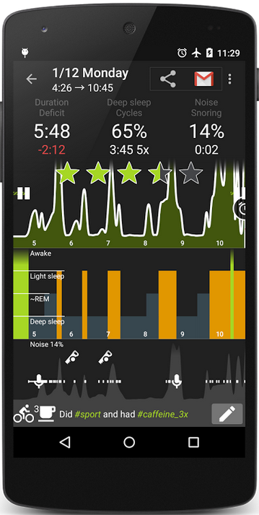
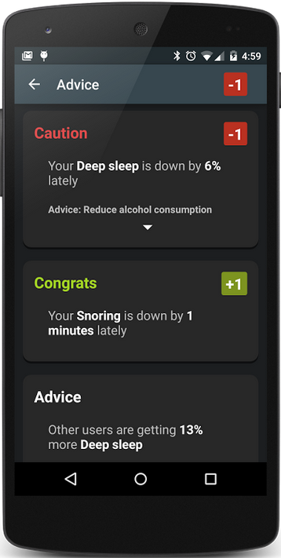

Slide 15
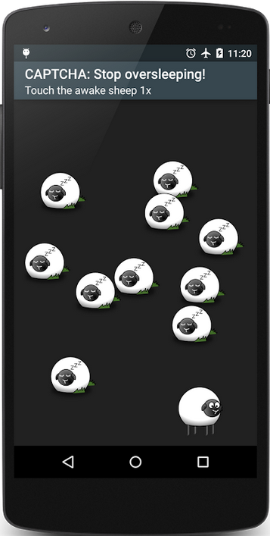
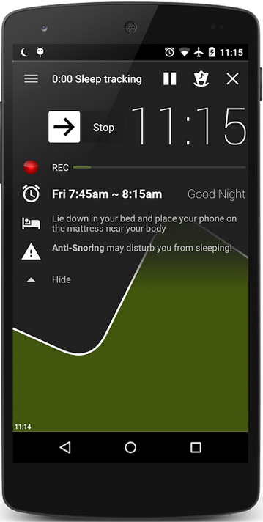

Slide 16

Good
Easy to use
Powerful automated entries
Excellent social functions
Swift, clean UI
Calorie differential and nutrition reports
And more! SparkPeople==Excellent
Bad
Full of ads
Full of links to parent website
Failed ‘SparkPoint’ system not removed entirely
Feature-rich diet and exercise coaching suite for losing weight

Slide 17
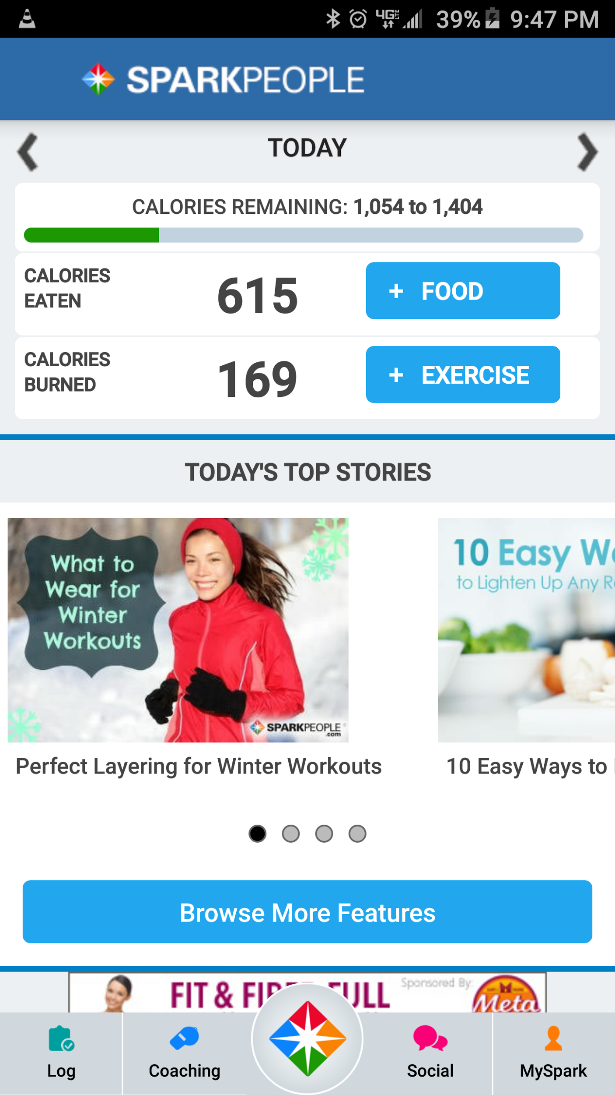
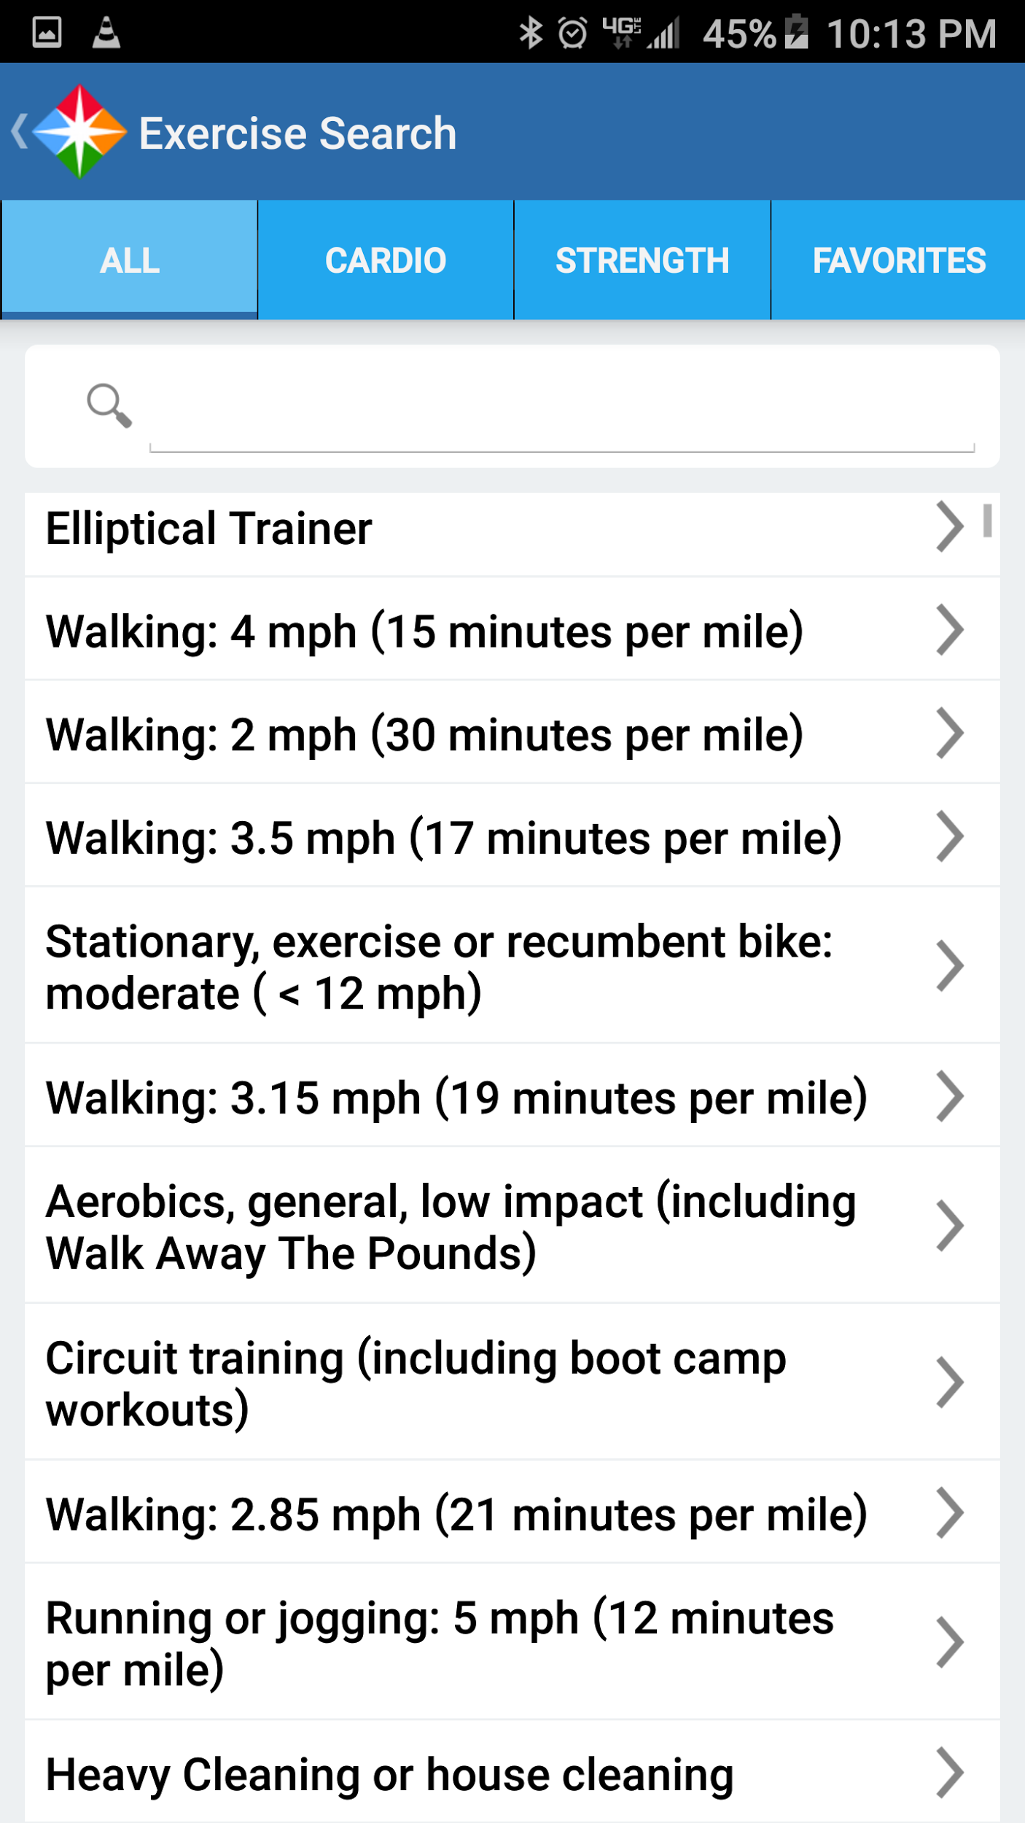
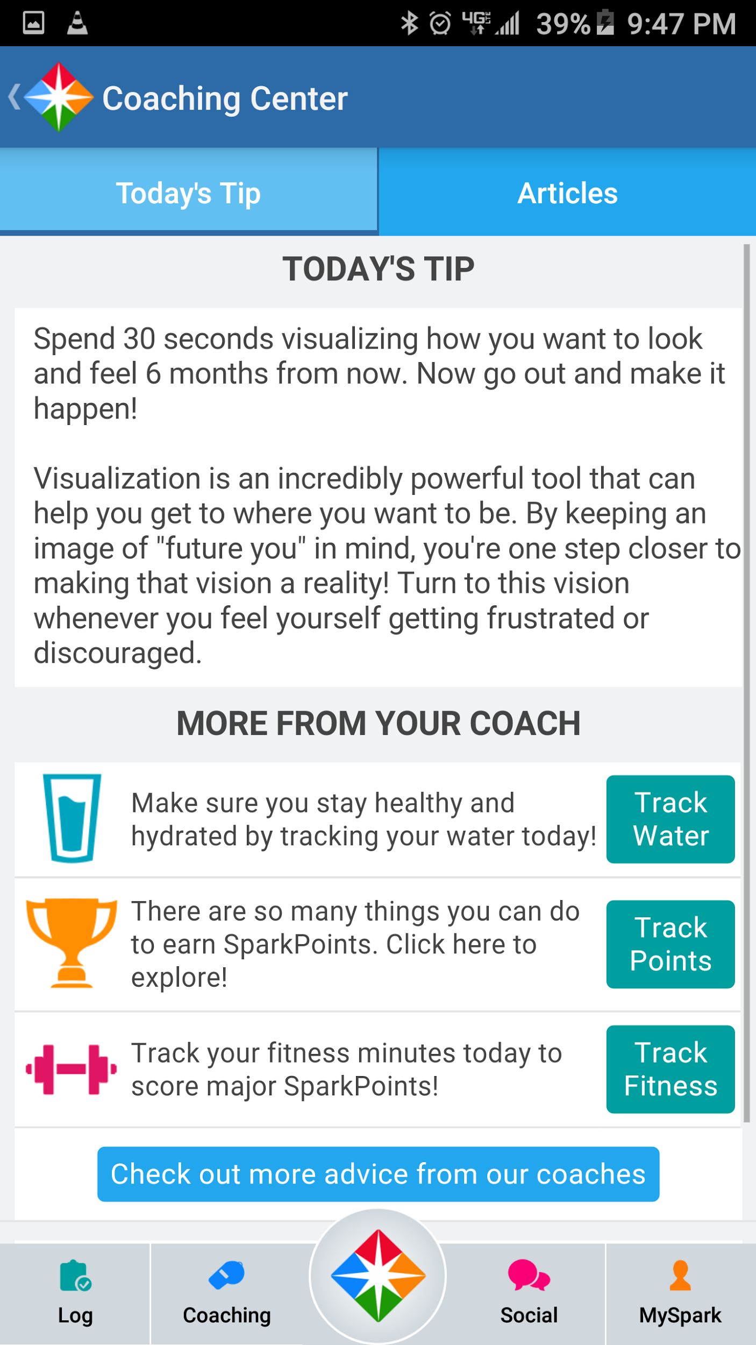

Slide 18
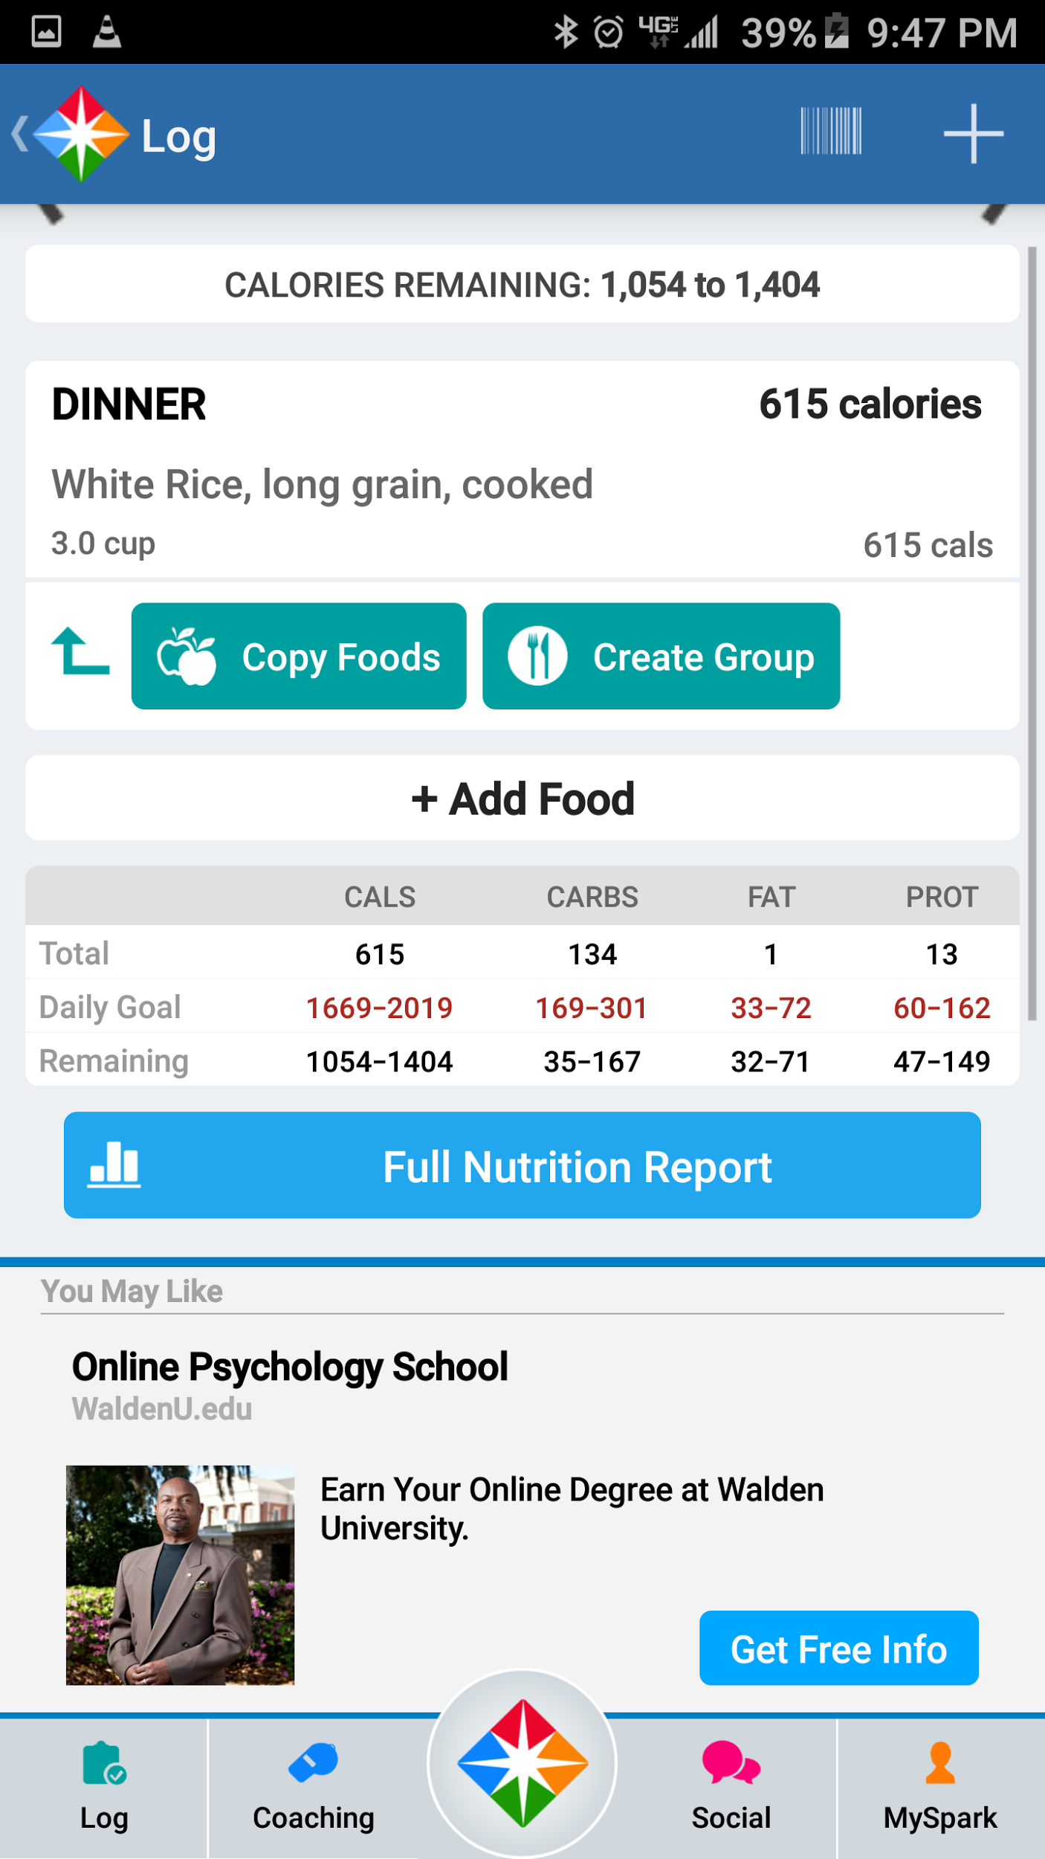
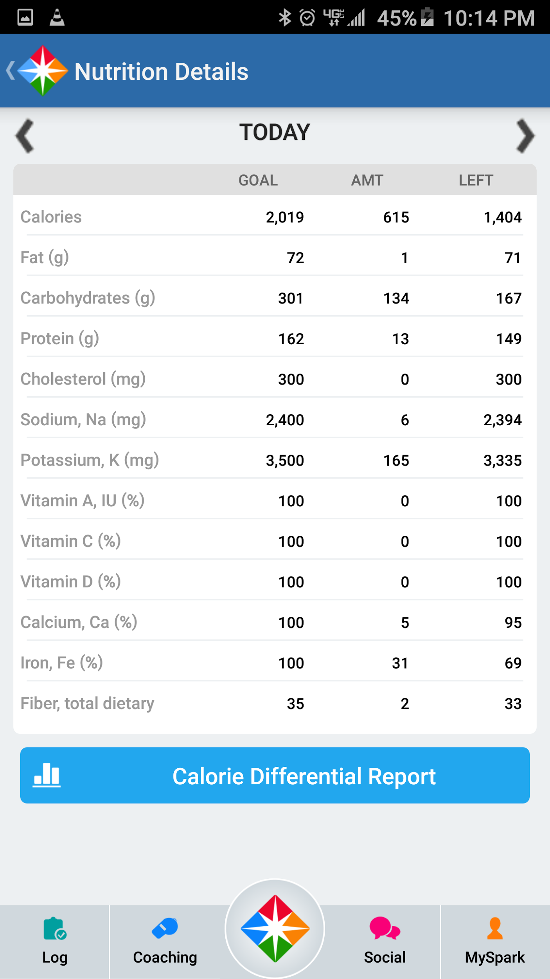
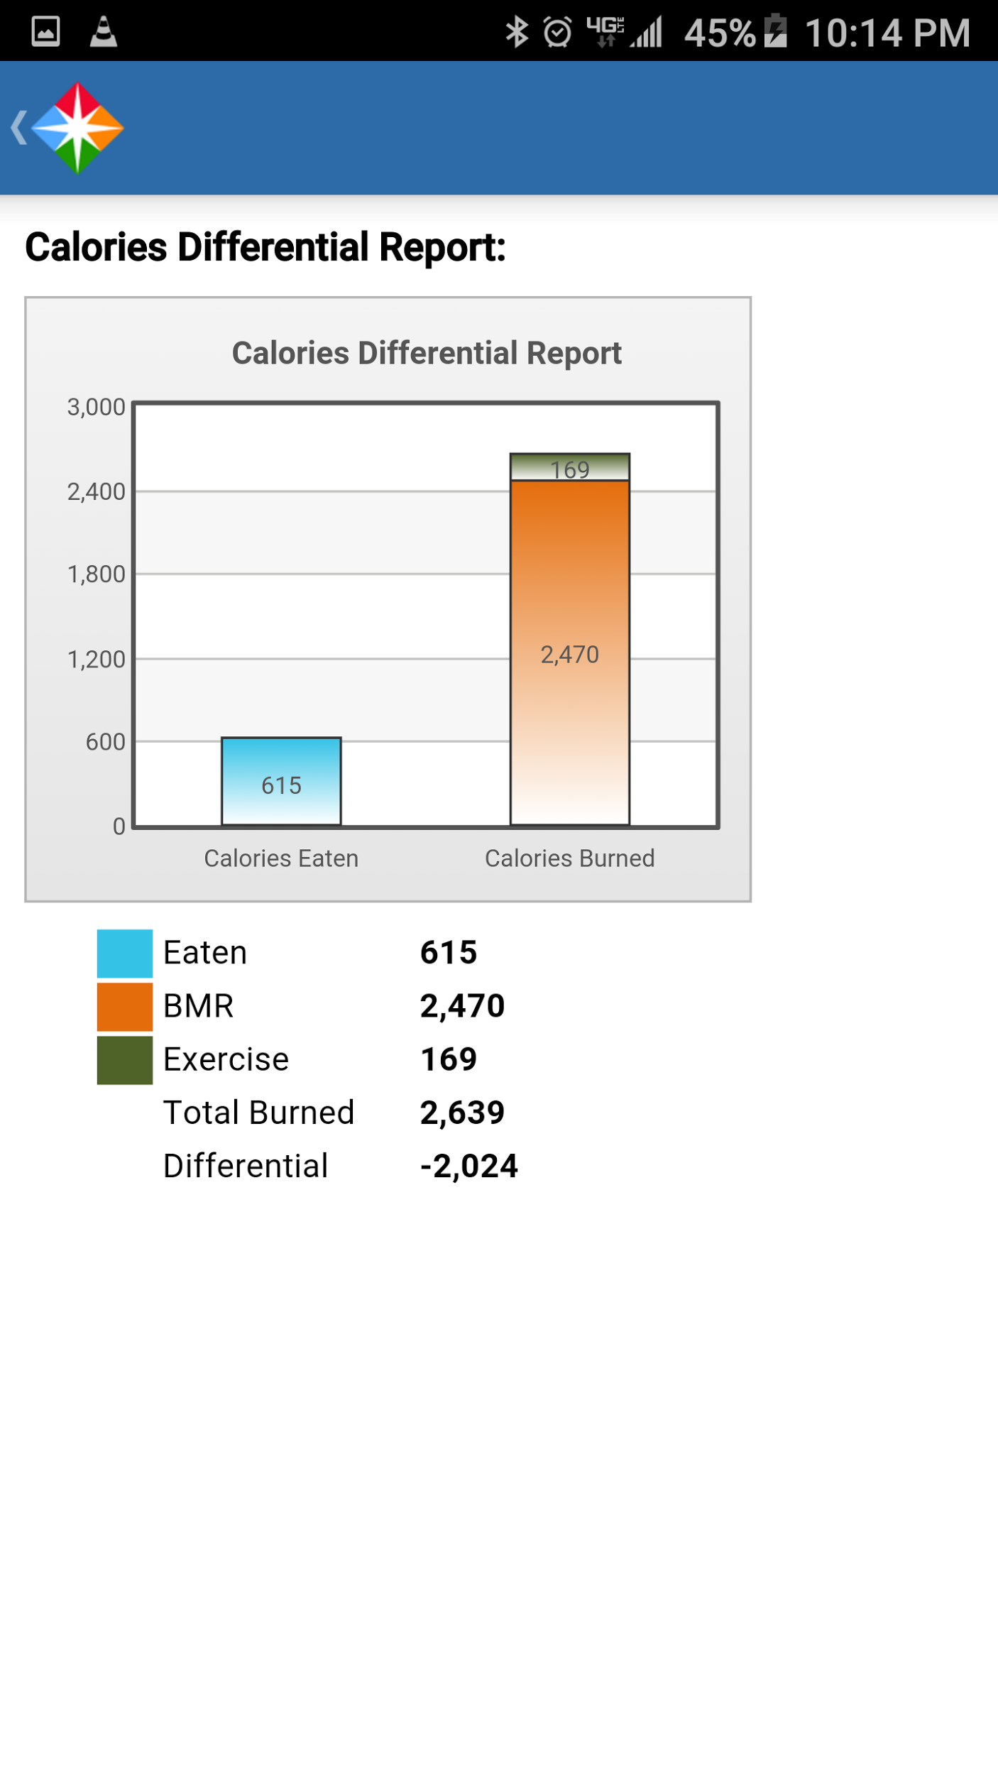

Slide 19
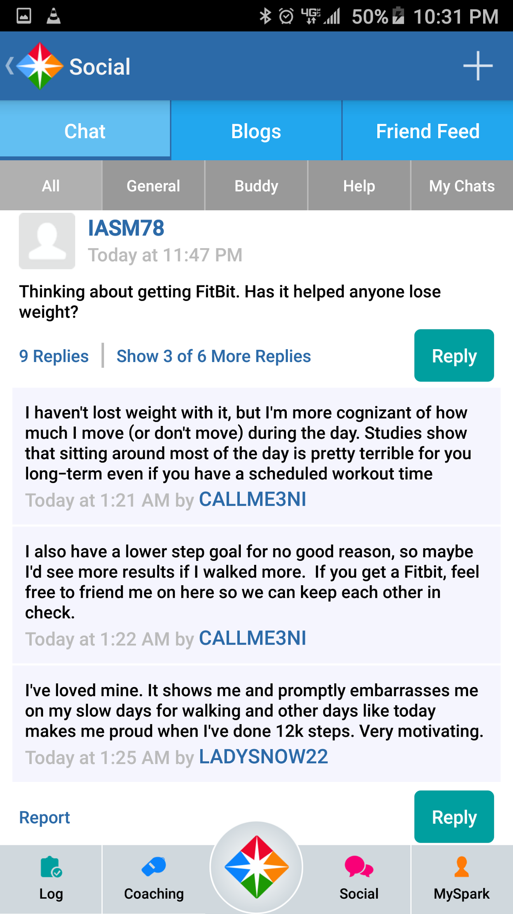
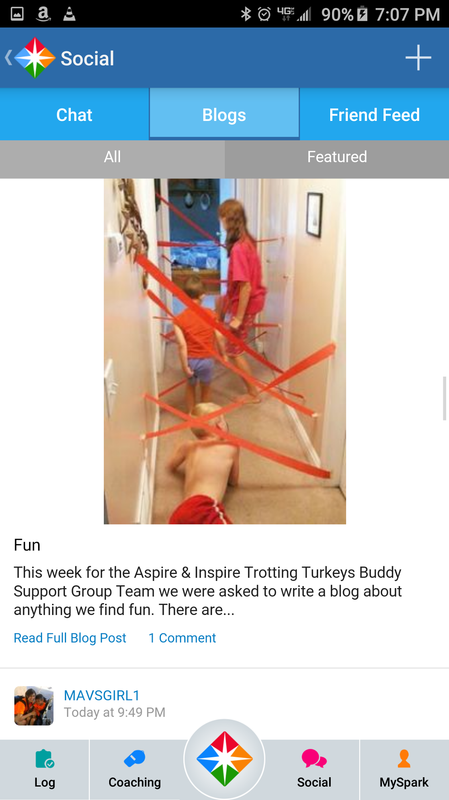
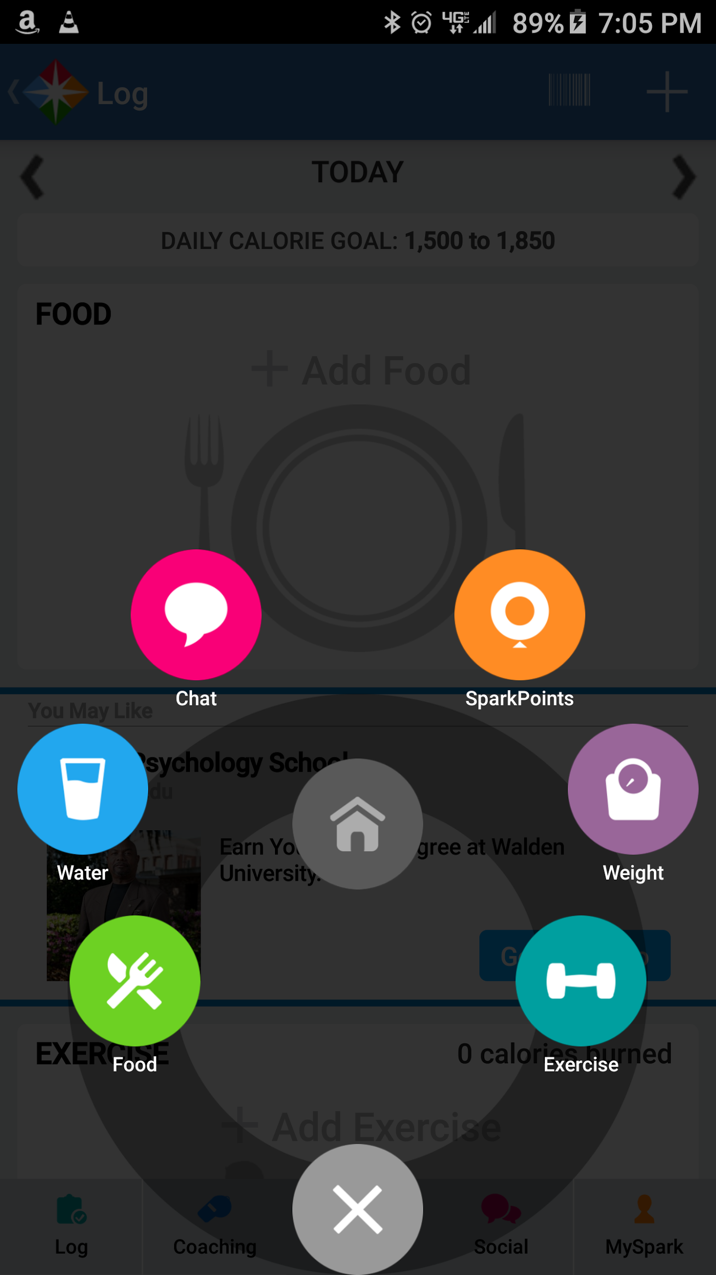

Slide 20


Good
Tracks medication types
Tracks doses
Tracks frequency
Has secondary ability to track doctors and appointments
Bad
Obnoxious pill bottle shaking notifications
Semi simple interface, had to dig for some features
Medisafe keeps the user on track with medications.

Slide 21
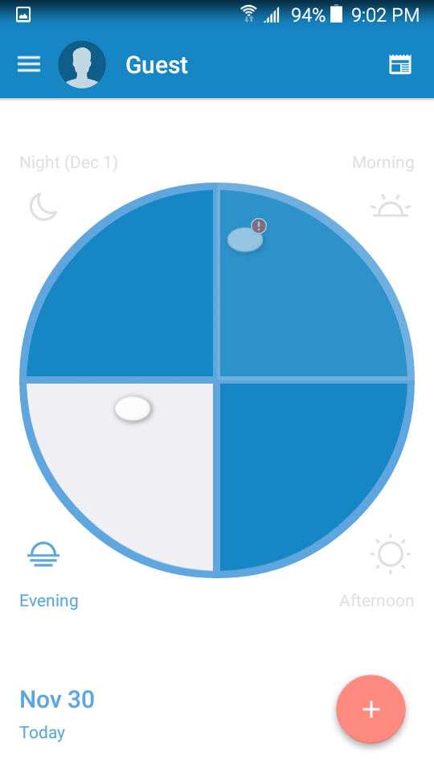
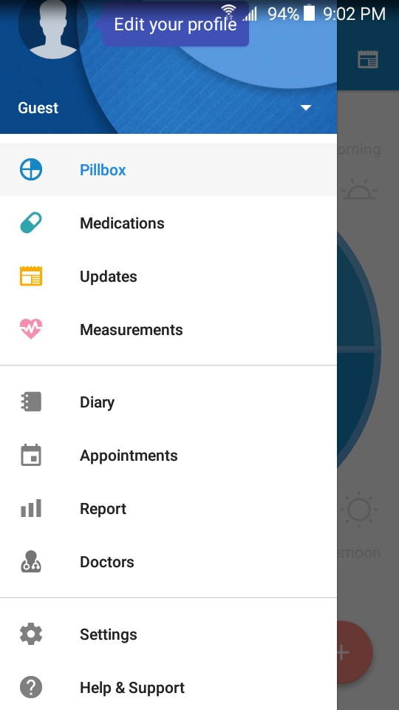
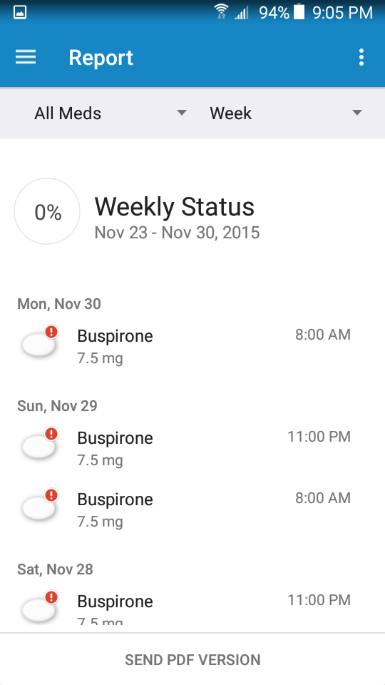

Slide 22
User Base
Notes:
JP

Slide 23
Target Users
People that want to find patterns related to mood, sleep, exercise, and diet
People with mental illnesses tracking data for personal or medical use
People who want to use one app for multiple health analytics
Notes:
Who are the target users and

Slide 24
User Motivation
Tracks multiple health aspects
Displays data in a graph that is easy to read
Displays possible patterns found through data analysis
Backs up user data
Notes:
what is their motivation to use the proposed system?

Slide 25
User Stories

Slide 26
Example user stories
User wants to enter the fact they only slept 3 hours.
Trouble remembering to take medication on time. User sets alarms.
User wants to track what they are eating and, if by supper time they haven’t managed to choke down a single vegetable - they want a reminder.

Slide 27
PJ the Power User
PJ is having trouble sleeping. He tries to use this app to help him.
After entering his diet, exercise amounts, stress levels, and video game hours (custom module PJ made in-app) in for 2 weeks:
PJ looks at the app’s analysis.
He notices that less exercise, more caffeine after noon, and not playing video games means less sleep at night. PJ expects that improving one or more of these biometrics will improve his sleep quality, schedule, and length.

Slide 28
Derived Requirements

Slide 29
App Requirements
Track and store data for different modules
Amount of time slept
Diet information
Medication
Set alarms/reminders for various activities
Wakeup
Exercise
Enter Biometrix data
Analyze data for trends

Slide 30
UI Support

Slide 31
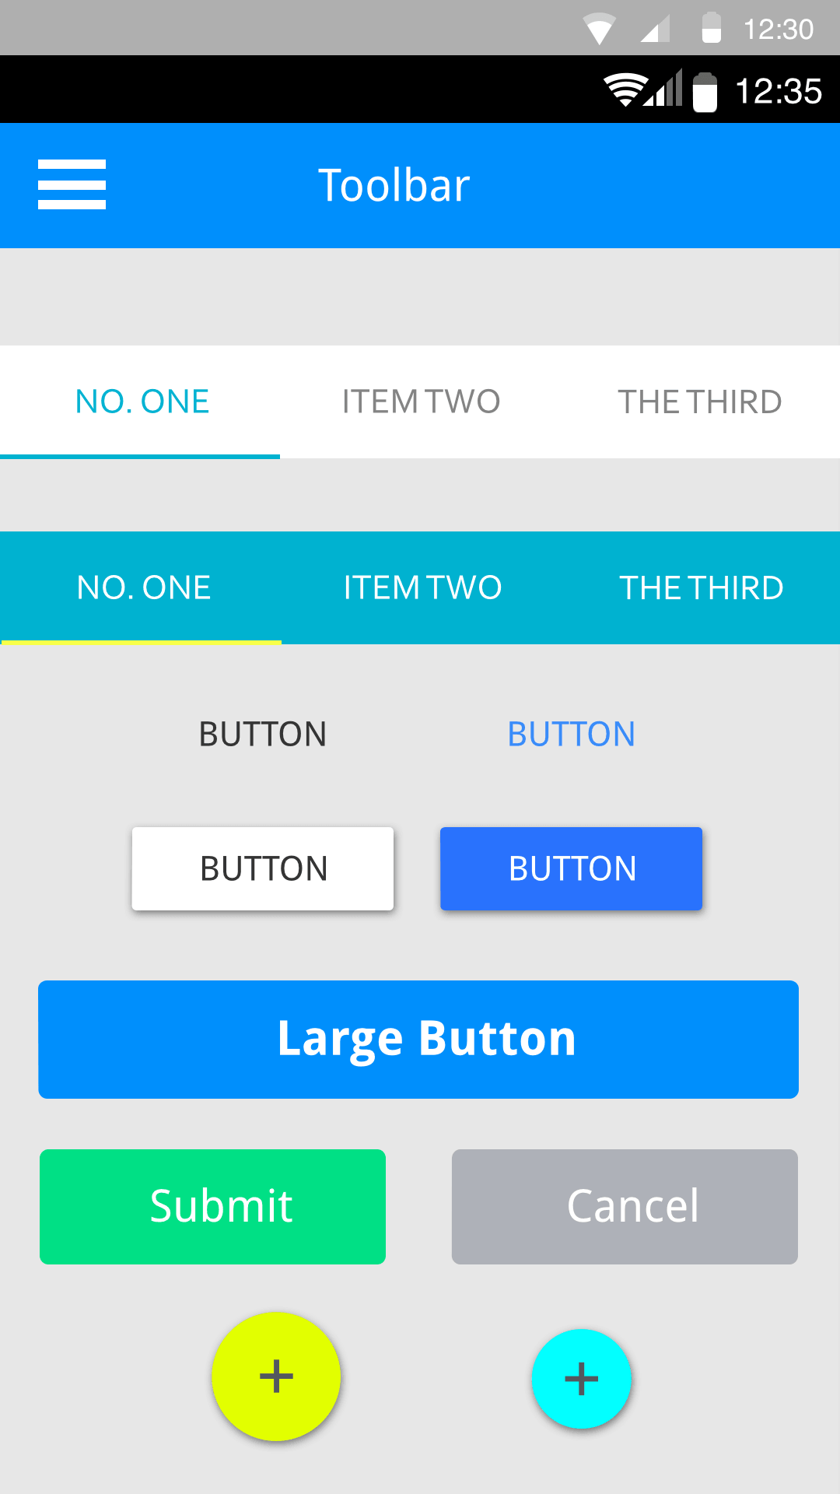
Android Material Design
Buttons ‘float’ and have tactile sensation when pressed
Toolbars are persistent and open dialog boxes or drop down menus
Taps, swipes, presses, etc. make noise and animate
An activity, or the screen you see, stacks like a TimTam. They are navigable by the hardware buttons on every Android phone
Clean, web-safe neutral color schemes
Sans-serif fonts
WYSIWYG

Slide 32
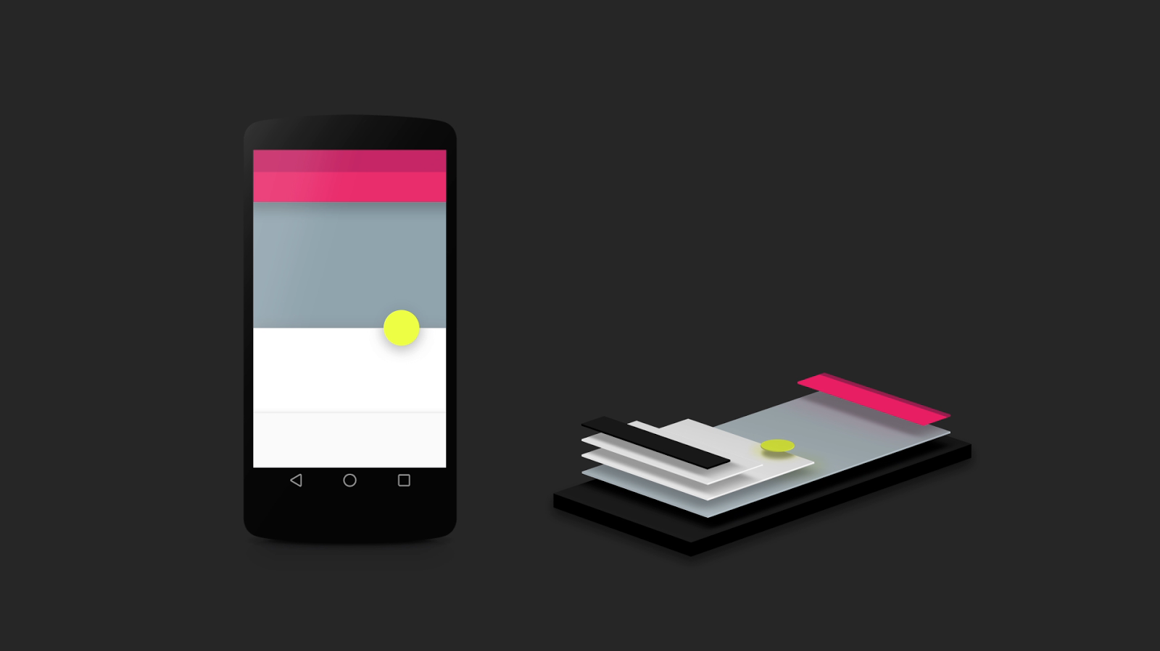
Just like TimTams
UI layered like TimTams too

Slide 33
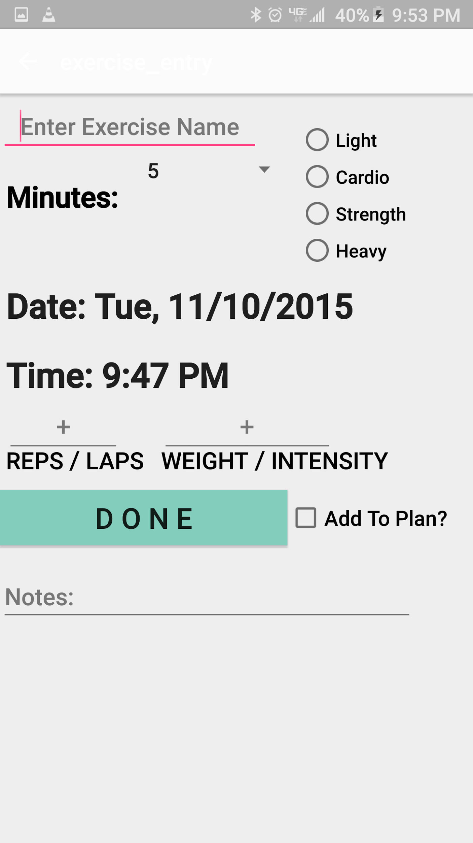
BioMetriX Keeps it Crispy
Default Android Material Design to be familiar
Emphasis on making daily data entry fast and automated where possible
Simple ‘+’ symbols to inform entry functionality
All buttons open new activities or dialog boxes

Slide 34
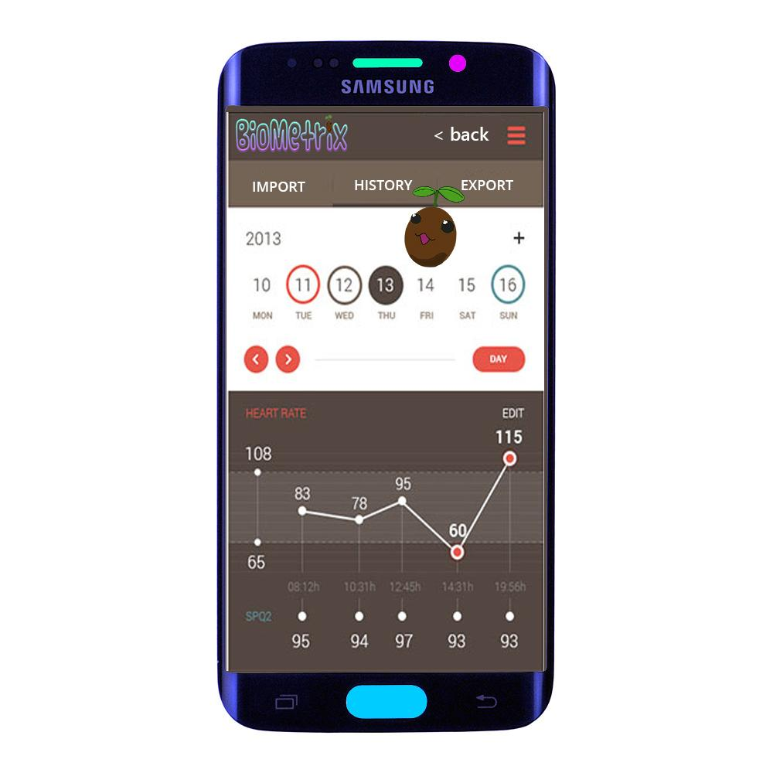

This isn’t even my final form
Adjustable color schemes -> “Earth Tone”
Floating animated guide character
Clear labels
BioMetriX home button
Return to previous activity with ‘back’
Tap the tool bar stack to quickly jump between modules
(Mock up may not represent final product)

Slide 35
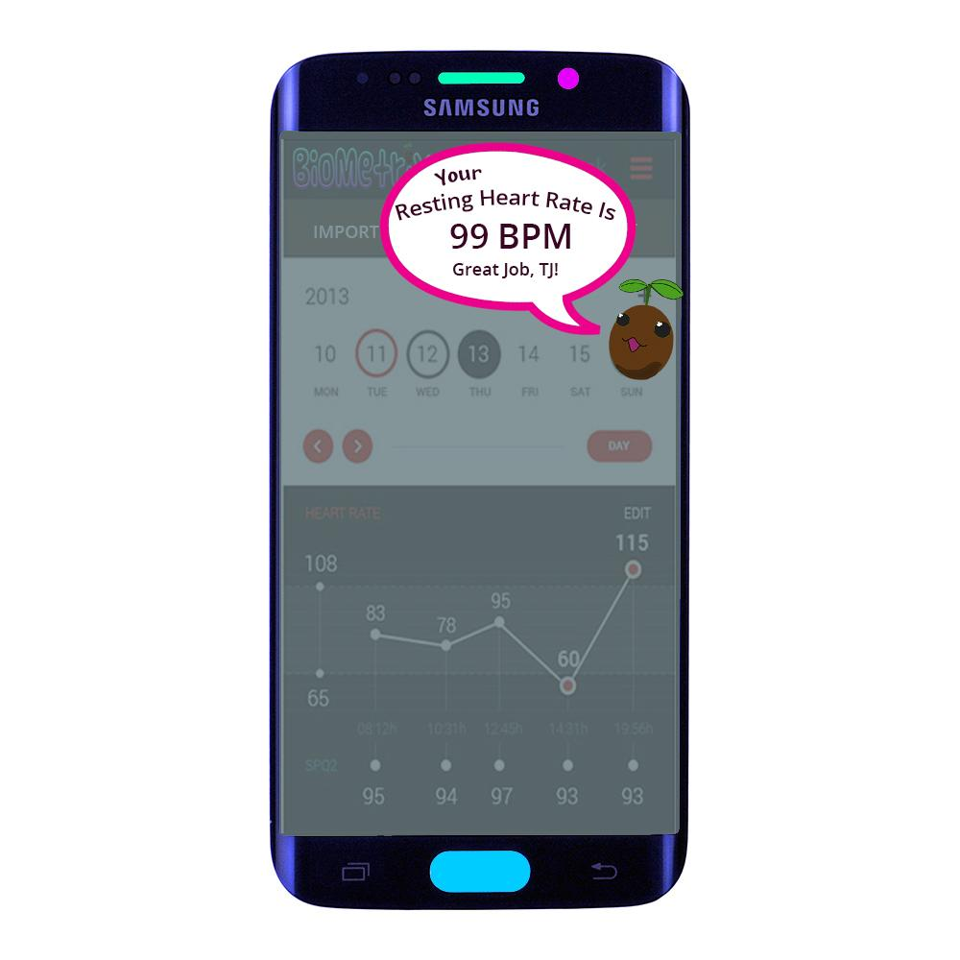

Why is the seed talking to me?
Tap ‘Sprout’ for context-sensitive info
‘Sprout’ teaches
‘Sprout’ encourages user to continue using app
‘Sprout’ points out interesting trends in your data
‘Sprout’ links you to other parts of app
Mock up may not represent final product. All sales are final
No refunds

Slide 36
Demo

Slide 37
Where We Are In Our Project

Slide 38
Progress
Home screen activity with functionality
Most modules have a ‘create entry’ activity
Defaults date and time to current
Changes date and time to any in the past
Module specific information inputs
Local database storage and retrieval for sleep module
Basic user login and create login

